Slide 1
Prediction of structural changes from mutation in human AlphaB Crystallin
Oriana Chen, Yujung Lin, Johnson Huang, Tina Ryu

Slide 2
Background
AlphaB Crystallin as an example
What is AlphaB Crystallin?
A small heat-shock protein found predominantly in the eye lens.
Essential for lens clarity and refractive functions by preventing protein aggregation.
Why AlphaB Crystallin?
Integral to maintaining lens transparency.
Mutations in AlphaB Crystallin are linked to cataract formation.
Represents a model protein to understand mutation-induced structural changes and diseases.
→Building prediction pipeline for AlphaB Crystallin
Notes:
In our project, we focus on AlphaB Crystallin, a small heat-shock protein that plays a critical role in maintaining the transparency and functionality of the human eye lens. This protein is not only fundamental for the lens's structural integrity but also in preventing the aggregation of unfolded or misfolded proteins, which is crucial for lens clarity throughout life.
The choice of AlphaB Crystallin for our project is based on its significant involvement in the eye lens and its link to cataract formation when mutated. Understanding how mutations influence AlphaB Crystallin helps us discover mechanisms of protein misfolding diseases, particularly cataracts.
For now, we design a prediction pipeline for AlphaB Crystallin and allows single point mutations on the amino acid sequence. By using our pipeline, users can efficiently get the pdb result and see how the mutation change the protein structure.

Slide 3
Packages
ESMFold
Core structural prediction directly from amino acid sequences
Biopython PDB
Extract structural information from PDB files
Perform structural alignment for PDB objects
DSSP
Determine protein secondary structure given a PDB file
Notes:
Our primary tool is ESMFold. This model allows us to predict protein structures directly from sequences, offering a solution for our structural prediction needs.
Once we have these predictions, we turn to Biopython PDB package including extracting and aligning structures from PDB files.
The last package we use is DSSP (Dictionary of Secondary Structure of Proteins) which is a Python package under Biopython that helps in predicting protein secondary structure based on its three-dimensional atomic coordinates. The assignment is based on the H-bonding patterns indicated by the residue coordinates. The assignment is achieved through the Define Secondary Structure of Proteins Algorithm, and the algorithm is currently used as the common method for determining protein secondary structure given a PDB file (such as in Pymol).
To run the complete pipeline, users have to construct a conda environment compatible with the required packages. Due to package incompatibility, some of our protein analysing modules can not be running on Bridges2 Environment, so the program is designed to run in two parts, with Bridges2 performing the mutation insertion / esmfold prediction and local Linux environment performing structural analysis. We prepared the yml files and installation manual for both cases so user can easily construct two different conda environments that supports the program in each case.

Slide 4
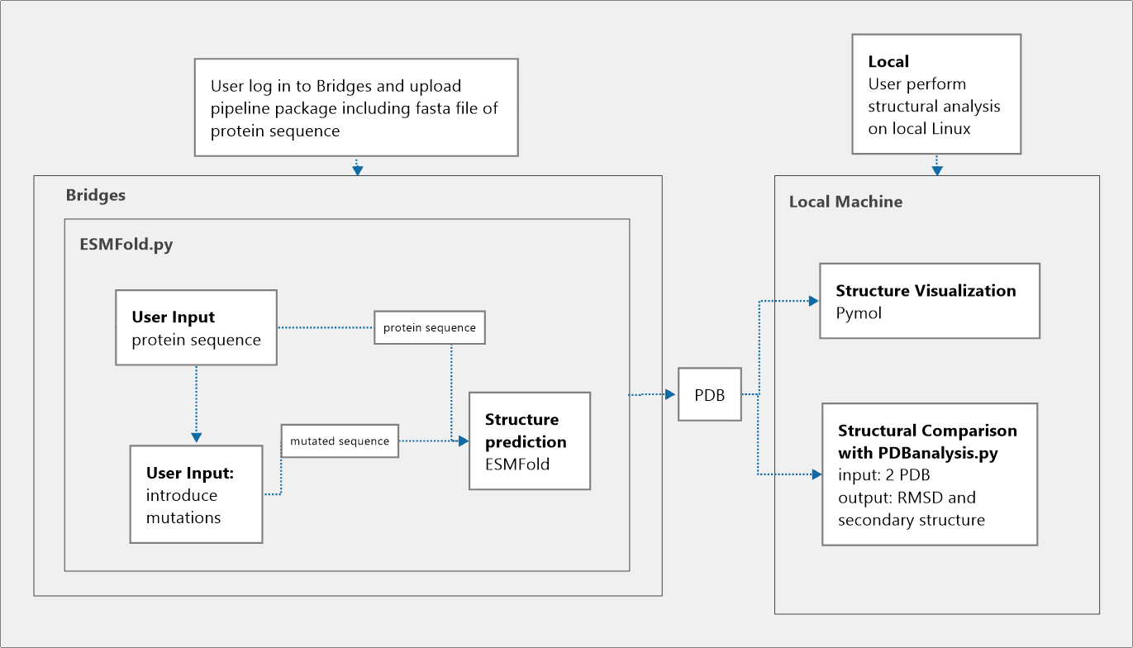
Workflow
Notes:
Our pipeline consists of 2 parts, one is on bridges and the other one is done on local machine. As mentioned before, this is due to the version conflict between bridges and module needed for PDBanalysis.

Slide 5
Pipeline
ESMFold.py
Introduce mutations
User input a protein sequence as a fasta file
Option to perform mutations or skip
Option to save mutated sequence to a new fasta file
structural prediction using ESMFold
Perform structure prediction on the input protein sequence
Output result as a PDB file
Notes:
The first section of the pipeline is introducing mutations and structure prediction
After logging onto bridges, installing all the necessary packages, and activating esmfold conda environment, users will run a script called ESMFold to initiate the first section of the pipeline.
it will first ask users to input the path to the fasta file containing the protein sequence. the fasta file can be downloaded from several websites such as uniprot and rcsb Protein data bank. After the input path is validated, users have the option to decide if they want to introduce point mutations to the sequence or if they want to proceed to running the prediction on the raw sequence.
If users choose to perform mutations, the prompt will ask users to input the mutations they want. then, users will be asked if they would like to save the mutated sequence to a fasta file.
Saving mutated sequence to a new fasta file is highly recommended since ESMFold takes file as an input
Therefore, if the user did not save the mutations they performed, no file can be submitted for ESMFold to predict.
Once the user enter the path, prediction will start.
The resulting PDB file will be saved in the same directory as the input fasta file

Slide 6
Pipeline (cont.)
PDBanalysis.py
3D structure comparison
Input 2 PDB files
Output differences as root mean square deviation (RMSD)
3D structure visualization
Upload PDB file to Pymol
various ways to visualize the structure
Notes:
The second section is structural analysis.
For this part, users will be running the program on their local machine.
There are two options for users to perform structure analysis. One is using our PDB analysis py and the other one is using Pymol.
For our PDB analysis py, users will be asked to input 2 PDB files for the structures they want to compare. The script will calculate the differences between the two structures and quantify the difference using root mean square deviation (RMSD). It will also perform secondary structure assignment on each residue.
If users want to look at the structure of the protein to see how mutations disrupt the structure, they can import the PDB file into Pymol.

Slide 7
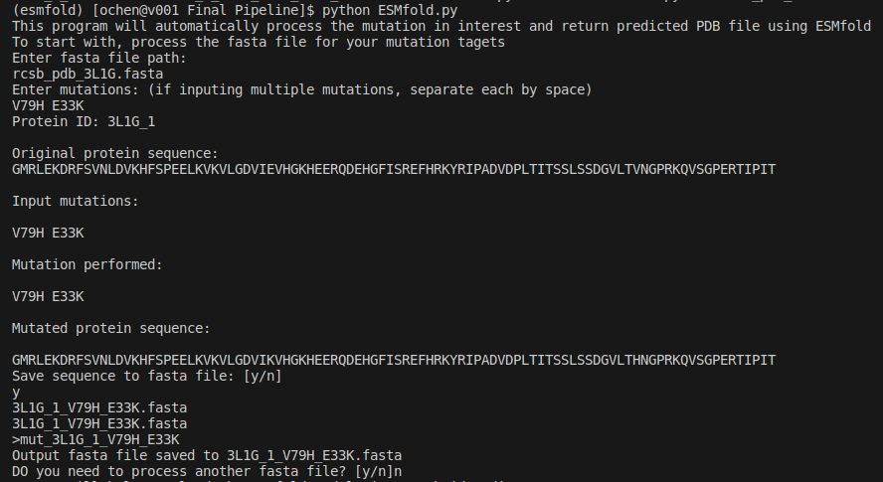
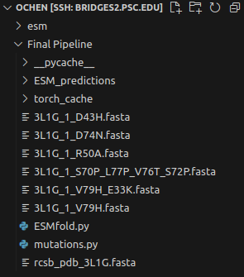
Demo
Insertion of Mutation and Model Prediction
Notes:
In this demo part we applied the pipeline on our target protein AlphaB crystallin.
With the original fasta file obtained from PDB database, we prepared 5 mutated protein sample, and obtained 5 fasta files that are ready to be delivered into the esmfold model. those file are stored in the same bridges 2 directory as the script.

Slide 8
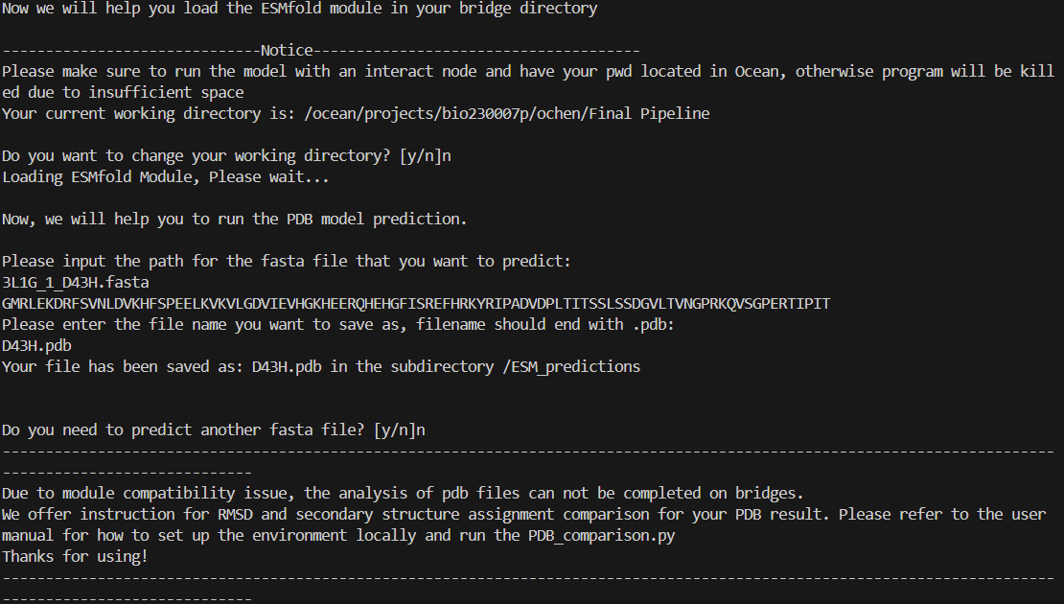
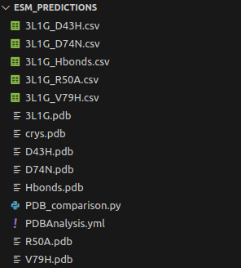
Demo
Insertion of Mutation and Model Prediction
Notes:
After the preparation, we established a esmfold model that will analyze each fasta file insequence, which output five mutated version of alphaB crystallin in the ESM prediction folder. Those files are stored within a prepared folder along with the yml file necessary for conda environment on local. We can directly download the folder from bridges when all prediction are finished.

Slide 9
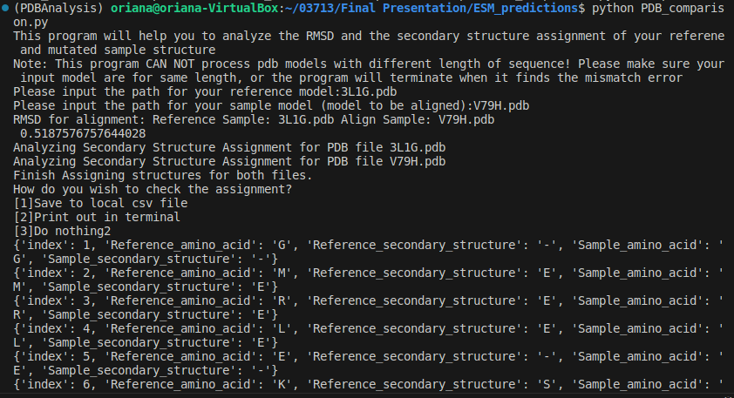
Demo
Local Analysis of Predicted Models
Notes:
Then lastly, in local enviornment we performed structural alignment and analysis of the mutated structure against the wild type structure 3L1G. We received the RMSD value for each pair comparison as well as the predicted secondary structure assignment for each pair of protein. Here used the option to store the secondary structure information in csv file for later data analysis.

Slide 10
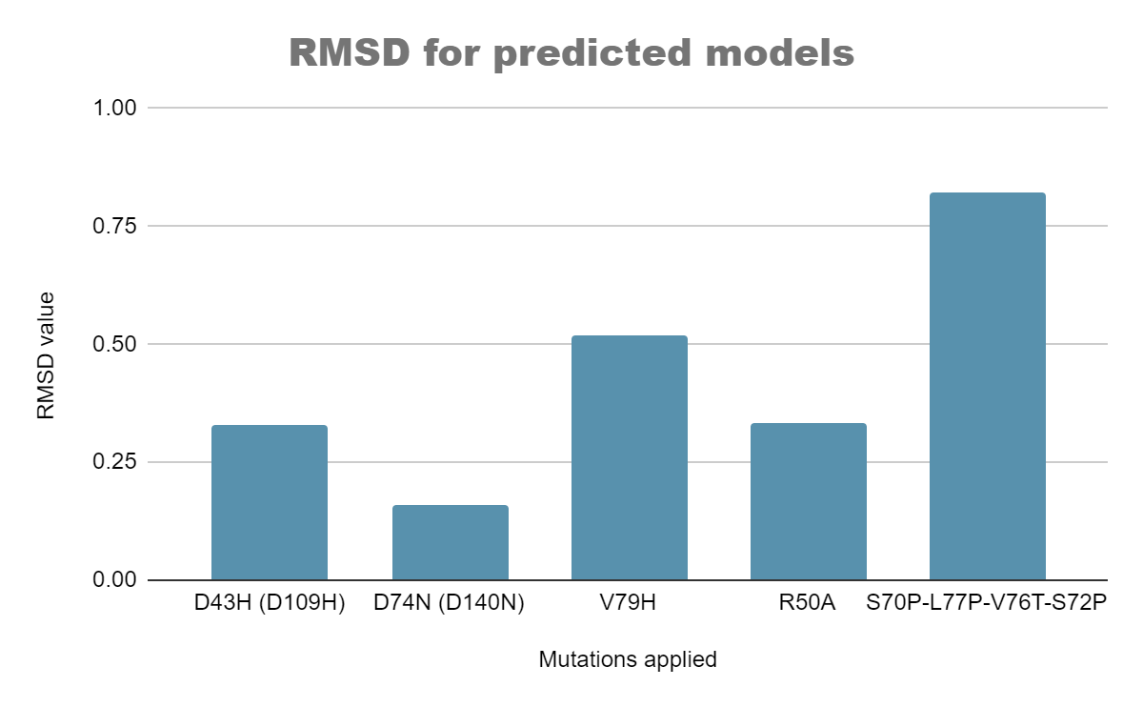
Results
RMSD for predicted models of AlphaB Crystallin
Mutations mentioned in literature
D43H (D109H)
D74N (D140N)
Mutation disrupts hydrophobic core
V79H
R50A
Mutations disrupt H-bonding for secondary structure
S70P-L77P-V76T-S72P
Notes:
Here is a overview of what the pipeline tells us about the mutation induced structural changes of alphaB crystallin. This is the RMSD result of different mutation we get from the pipeline, we can see this time with the help of esmfold we are able to see a change of RMSD comparable to the expected degree of influence from point mutations. Generally we see a larger RMSD when mutation like V79H that significantly disrupt hydrophobic core, and group mutations that disrupt the anti-parallel beta sheet. Compared to mini-demo we think esmfold is a better model for analyzing point mutation than Robetta, making the pipeline more informative for this kind of analysis.

Slide 11
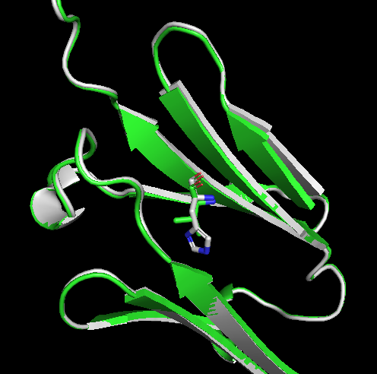
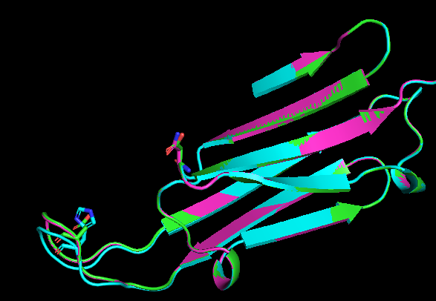
Results
Pipeline / Model Prediction Analysis for point mutation
3L1G (predicted)
D43H (D109H)
D74N(140N)
V79H
Notes:
Goes into the detail of the result, we used Pymol as a support tool to visualize the prediction, and get an idea of where the difference of RMSD comes from.
We can see for mutations mentioned in literature (picture on right), those are mutations occur on twists and mainly participate in interaction between monomers. As here we only predict monomer conformation such we might not able to directly capture those changes. However esmfold still helps to analyze the potential residue shift at those boundary regions, such as in D43H we can see a outward shift of the twist which clearly does not occur in other models.
For V79H, we can see esmfold model respond to the disruption of hydrophobic core and predicted a opening of the beta sheet sandwich.This is a good news showing esmfold is a better AI structural prediction model for missense mutation compared to Robetta, it will have the ability to show potential changes of unseen point mutation in the data base by referring to changes intramolecular relationship.

Slide 12
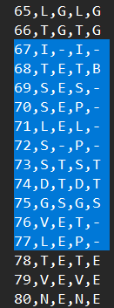
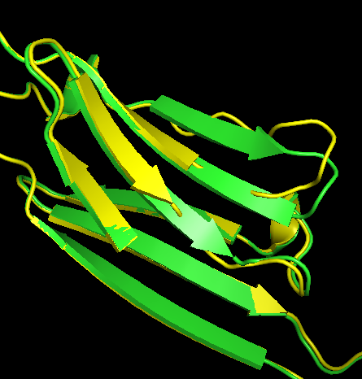
Results
Pipeline / Model Prediction Analysis for multiple mutations
3L1G (predicted) S70P-L77P-V76T-S72P
DSSP prediction result
===== ====
Code Structure
===== ====
H Alpha helix (4-12)
B Isolated beta-bridge residue
E extended strand in parallel and/or anti-parallel β-sheet
G 3-10 helix
I Pi helix
T Turn
S Bend
\- None
===== ====
Notes:
Finally, we choose inserting the group of mutations as a demonstration of cases when user’s input might disrupt secondary structure assignment,(proof of concept example). . Here we can see that the original anti-parallel beta sheet changed into disordered region as in the prediction result. Such changes is actually captured by our pipeline analysis as you can see in the highlighted region of the csv file.
Overall, the demo shows the improved capability of our pipeline to analyze mutation induced structural changes in proteins, such as in cases of AlphaB crystallin where local residue location plays an important role in the protein function.

Slide 13
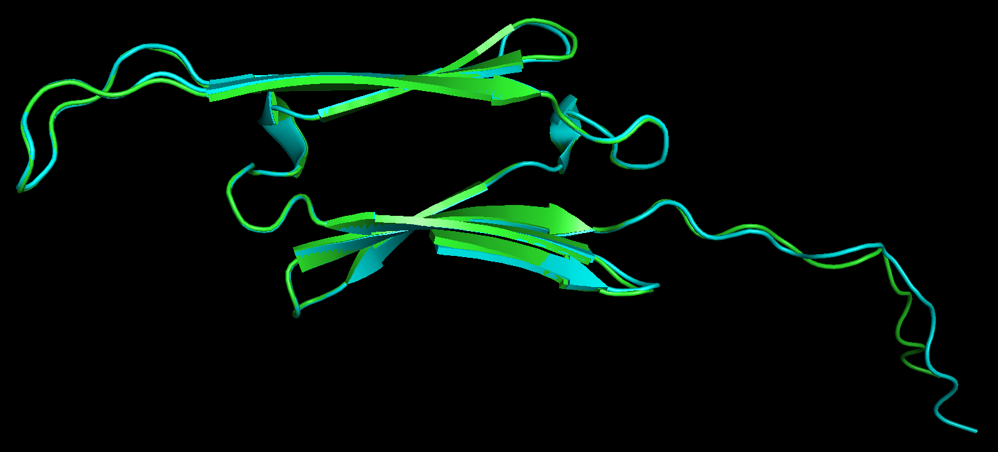
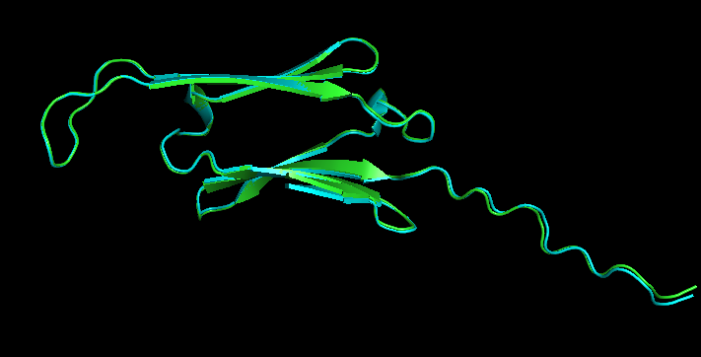
Discussion
Conclusions
better protein structure prediction (esmfold vs Robetta)
loop region
cataract causing mutation structural change can be captured in ESMfold predicted structure (example: V79H)
more mutations -> higher RMSD
H-bonding disruption causes significant change in structure
Robetta V79H vs. WT
ESMfold V79H vs. WT
Notes:
The pipeline has even larger potential when it is applied on some protein that does not have a identified crystallized structure. Using the pipeline user can have an idea of the outcome of proposed mutation before performing laboratory analysis, using computational power to save time and resources.
use alpha B crystallin to see if pipeline works
since validation we implement for other proteins
RMSD change is due to mutation or not ?
and secondary structure

Slide 14
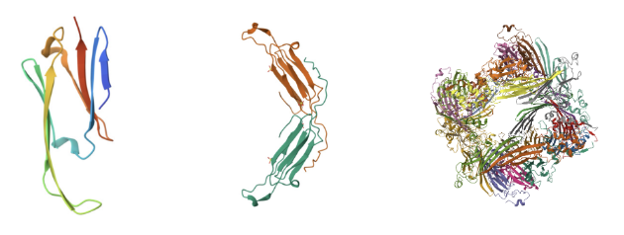
Discussion
Limitations
Limited to point mutations
RMSD is the sole indication of 3D structural differences
further examination is needed to determine the details of structural change
Cannot predict mutation effect on oligomerization -> cannot predict protein functionality
Notes:
structural change -> functional change
cannot reason for other reasons (chemical interaction changes) cause functionaol changes…

Slide 15
Discussion
Future Improvement
Conda environment dependencies - compatibility
Implementation of frameshift mutations
different lengths (module)
Implementations of other algorithms for structure disruption measurement
Alphafold
Notes:
make pipeline more user-friendly
advance analysis ->

